Slide 1
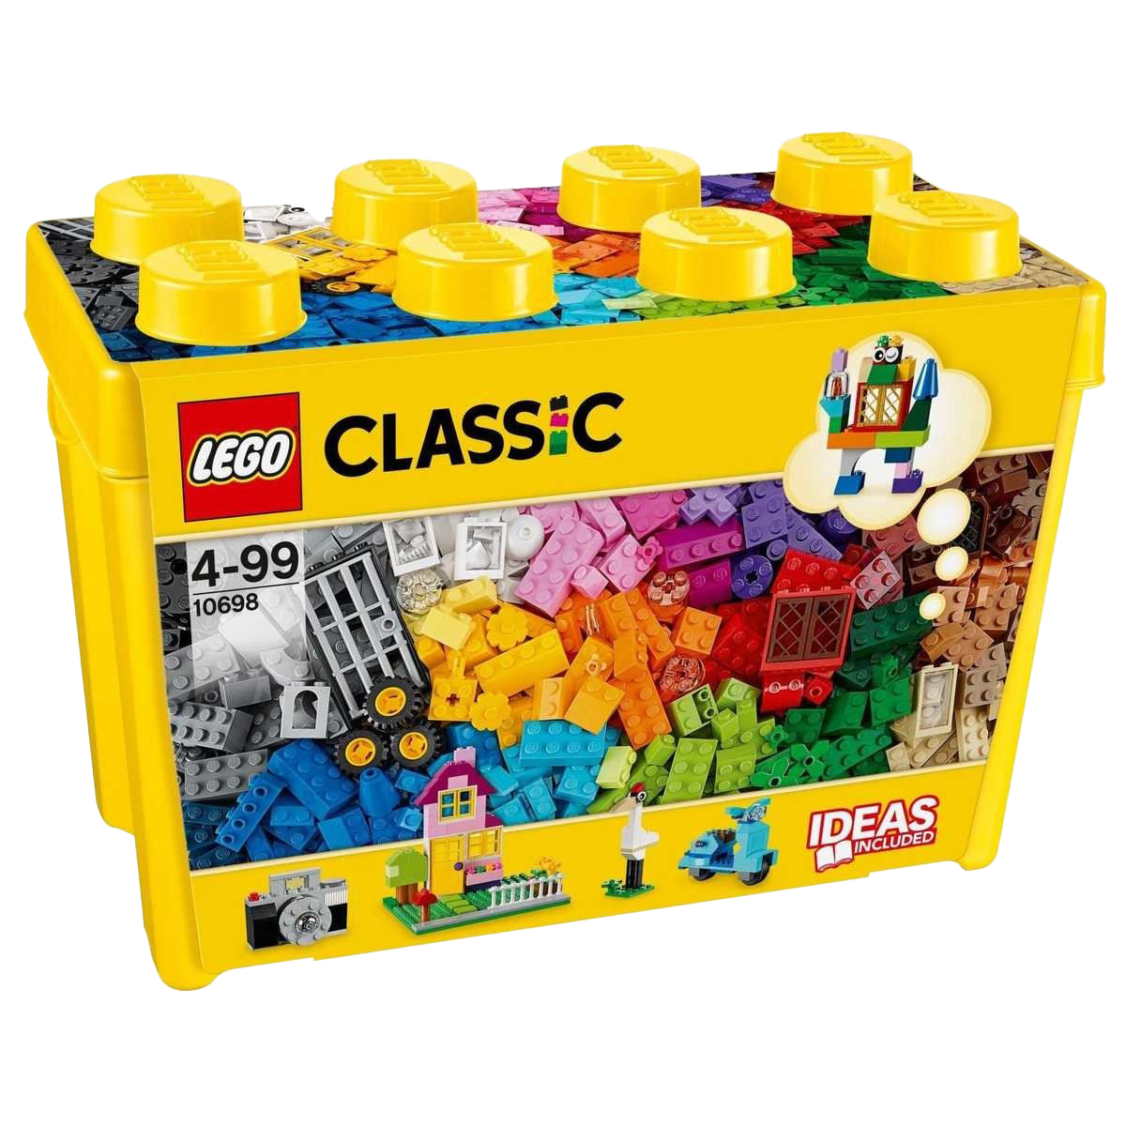
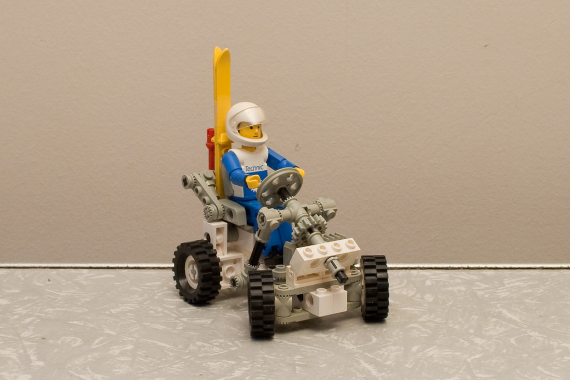
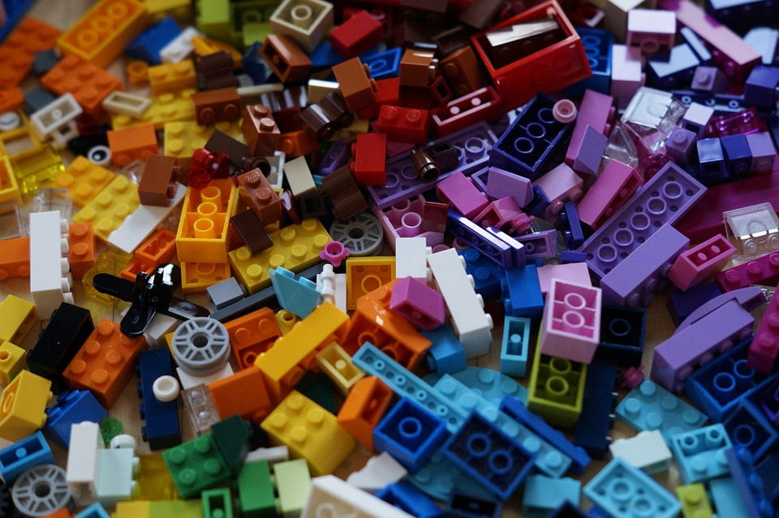
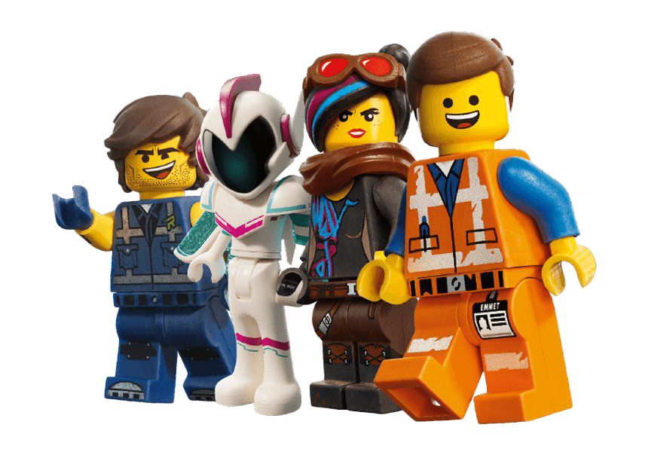
Lego
This Photo by Unknown Author is licensed under CC BY-SA
Scoil Chroi Ro Naofa
This Photo by Unknown Author is licensed under CC BY-NC
This Photo by Unknown Author is licensed under CC BY
This Photo by Unknown Author is licensed under CC BY-NC

Slide 2
Lego lab
After we looked at that, Vince showed us examples of his lego mobile.
Then we worked alone or in groups of 2 or 3 to build our own mobile
Today we had a person called Vince from Amazon come into the school to teach us coding with lego.
We watched videos about AI and how to train robots.
We watched a video of an amazon warehouse where a girl with no experience worked with 800 robots.

Slide 3
Lego mobile
We used a tablet to follow instructions.
We used coding lego and batteries to make it move.
We used the sounds by pressing a button on the tablet this creates a code to send to the robot.
Thay are connected by bluetooth.
This Photo by Unknown Author is licensed under CC BY-SA-NC

Slide 4
Rubix cube robot
Vince brought in a robot that solves a rubix cube.
Vince said the fasted a robot completed a rubix cube was 0.3 seconds
This Photo by Unknown Author is licensed under CC BY

Slide 5
This Photo by Unknown Author is licensed under CC BY-ND

Slide 6
THINK BIG SPACE
Think big space in located in Tallaght besied the square. They do lots of logo coding and they use lots of technology.

